Slide 1
Probability and Statistical Inference
Assessing Your Distribution –Does it fit the normal distribution?
Sources used in creation of this lecture:
Statistics and Data Analysis, Peck, Olsen and Devore; Discovering Statistics Using R Field, Miles and Field; Understanding Basic Statistics, Brase and Brase

Slide 2
How do I inspect a scale (interval/ratio) variable?
Generate plots
Generate a histogram with a normal curve showing
Generate a Q-Q plot (detrended if you wish)
Generate summary statistics
This should include calculating measures of skewness and kurtosis – standardised scores
Review your statistics and plots to see how far away from normal your data is
Report the correct statistics based on your assessment of whether your data can be considered to follow the normal distribution

Slide 3
Example Pearson Correlation
For the dataset survey.dat (R)
SPSS Survival Manual 6th Edition Julie Pallant
http://spss.allenandunwin.com.s3-website-ap-southeast-2.amazonaws.com/data-files.html#.Wb0vvnWP-po
Dataset created from a designed to explore the factors that impact on respondents’ psychological adjustment and wellbeing.
R dataset has been made available to you (survey.dat)
To load the data in R the command is (as usual change the location to reflect where you have the file saved
survey <- read.table("survey.dat”)
PSIWeek4.rmd R notebook which contains all the commands used in this lecture.

Slide 4
Example Pearson Correlation
Question:
“Is there a relationship between respondents’ feelings of control and their level of perceived stress?
Concept: Feeling of being control
Total PCOISS derived from the PCOISS questionnaire (tpcoiss)
Variable name: TPCOISS
Variable type: scale
Dependent/Outcome variable
Concept: Perceived Stress
Total perceived stress derived from the perceived stress questionnaire
Variable: tpstress
Variable type: scale
Independent variable

Slide 5
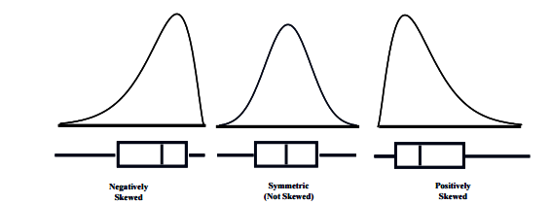
Plots and Histograms of the observed data

Slide 6
Normal Quantile Plot (Q-Q Plot)
Quantile-Quantile Plot (Q-Q Plot)
Helps us to assess whether our data can be considered to plausibly came from some theoretical distribution such as a Normal distribution
A scatterplot created by plotting two sets of quantiles against one another.
If both sets of quantiles came from the same distribution, we should see the points forming a line that’s roughly straight.

Slide 7
Normal Quantile Plot (Q-Q Plot)
What are “quantiles”?
These are often referred to as “percentiles”.
These are points in your data below which a certain proportion of your data fall.
For example:
For a standard Normal distribution with a mean of 0 (the peak of the bell curve)
The 0.5 quantile, or 50th percentile, is 0.
Half the data lies below 0.
The 0.95 quantile, or 95th percentile, is about 1.64.
95 percent of the data lies below 1.64.
Quantiles are basically just your data sorted in ascending order, with various data points labelled as being the point below which a certain proportion of the data fall

Slide 8
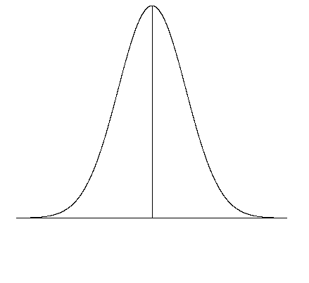
Normal Quantile Plot (Q-Q Plot)
Basically compares the spacing of our data to what we would expect to see in terms of spacing if our data were approximately normal.
If our data is approximately normally distributed, we should spacing that is similar that on the normal curve on the right.
Very few observations in both tails and increasingly more observations as we move towards the mean from either side.
Also remember the spacing must be symmetric about the mean.

Slide 9
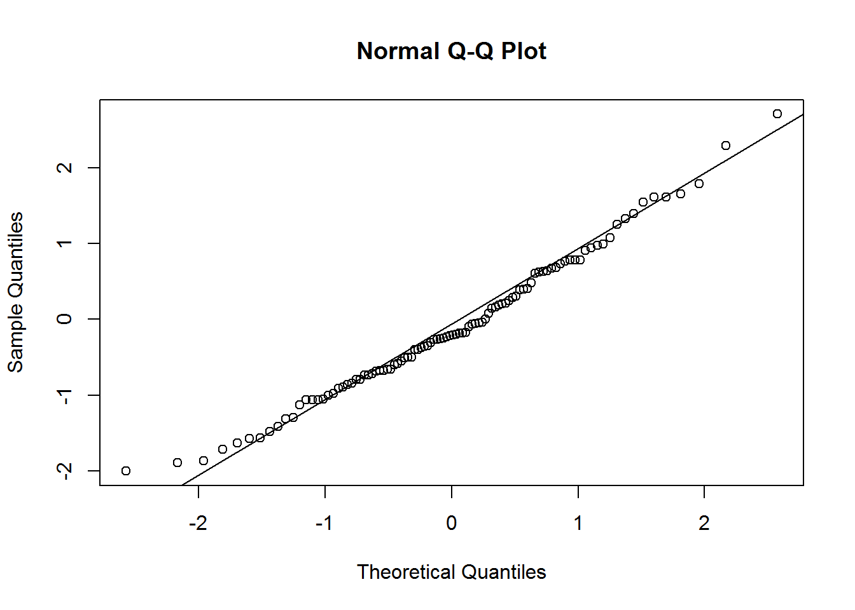
Normal Quantile Plot (Q-Q Plot)
THE IDEAL PLOT:
The plot on right is a Q-Q plot with the data on the vertical axis (observed) and the expected z-scores if our data was normal on the horizontal axis.
When our data is approximately normal the spacing of the two will agree resulting in a plot with observations lying on the reference line in the normal quantile plot.
When looking at a Q-Q plot, you should look for points that stray far from the line of expected values, as well as trends in the observed values.

Slide 10
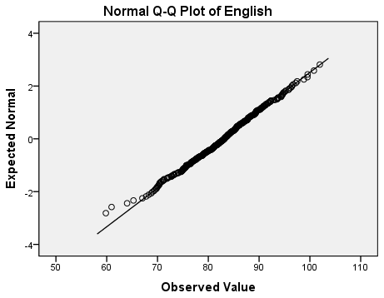
Normal Quantile Plot

Slide 11
Detrended Q-Q Plot
In the Detrended Plot, the horizontal line at the origin represents the quantiles that we would expect to see if the data were normal;
The dots represent the magnitude and direction of deviation in the observed quantiles.
In a normal distribution we would expect points to be evenly distributed above and below the line.

Slide 12
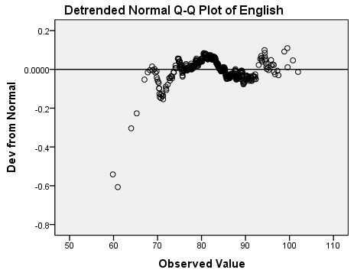
Detrended Q-Q plot
The horizontal line at the origin represents the quantiles that we would expect to see if the data were normal
The dots represent the magnitude and direction of deviation in the observed quantiles.
Each dot is calculated by subtracting the expected quantile from the observed quantile.
This implies that if a dot is below the trend line on the Normal Q-Q plot, it will appear above the trend line on the Detrended Normal Q-Q plot, because observed - expected > 0.

Slide 13
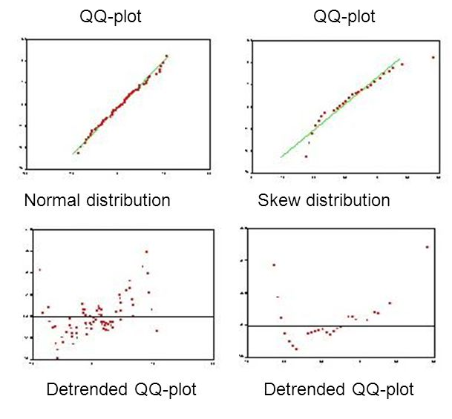
QQ Plots and Detrended QQ Plots

Slide 14
Our Example
Need to inspect two variables
Concept: Feeling of being control
Total PCOISS derived from the PCOISS questionnaire (tpcoiss)
Variable name: TPCOISS
Variable type: scale
Dependent/Outcome variable
Concept: Perceived Stress
Total perceived stress derived from the perceived stress questionnaire
Variable: tpstress
Variable type: scale
Independent variable

Slide 15
Generate the Graphs
Generate histogram
Generate Q-Q plot
Inspect by eye

Slide 16
Generate Summary Statistics
Need to see how far away from normal our data is
Calculate standardised scores for skew and kurtosis
Calculate the percentage of standardised scores are outside the acceptable range
95% within +/- 1.96
99.7% within +- 3.29 for larger distributions

Slide 17
What do I need to describe for interval/ratio data?
Centre
Discuss where the middle of the data falls
Measures of central tendency
mean, median
Spread
Discuss how spread out the data is
Refers to the variability in the data
Standard deviation, IQR
Shape
Refers to the overall shape of the distribution
Symmetrical, uniform, skewed, or bimodal
Quantify level of skew and kurtosis

Slide 18
What do I need to describe for interval/ratio data?
Unusual Occurrences
Outliers (value that lies away from the rest of the data)
Gaps
Clusters
Context
You must write your answer in reference to the context in the problem, using correct statistical vocabulary and using complete sentences.

Slide 19
Quantifying Skew and Kurtosis
Goodness of Fit Tests
Shapiro-Wilk Test (small dataset)
Kolmogorov-Smirnov Test (larger dataset)
These are unreliable if your dataset is large
Recognized heuristics
Standardized skewness and kurtosis
Percentage of standardized scores falling within acceptable ranges

Slide 20
Quantifying Skew and Kurtosis
Goodness of Fit Tests
Shapiro-Wilk Test (small dataset)
Kolmogorov-Smirnov Test (larger dataset)
These are unreliable if your dataset is large
Recognized heuristics
Standardized skewness and kurtosis
Percentage of standardized scores falling within acceptable ranges

Slide 21
Quantifying Skew and Kurtosis
Goodness of Fit Tests
Shapiro-Wilk Test (small dataset)
Kolmogorov-Smirnov Test (larger dataset)
These are unreliable if your dataset is large
Recognized heuristics
Standardized skewness and kurtosis
Percentage of standardized scores falling within acceptable ranges

Slide 22
Tests of Normality
Standardised scores (value/std.error) for skewness between +/-2 (1.96 rounded) are considered acceptable in order to prove normal univariate distribution.
George, D., & Mallery, M. (2010). SPSS for Windows Step by Step: A Simple Guide and Reference

Slide 23
Our example
Tpcoiss:
Standardised Skew = -.401/.118=-3.40
Standardised Kurtosis=.257/.236=1.08
Skewness is not acceptable so we need to look into this further.
Need to look at the outliers, how many of them there are or whether we can transform it to become more normal.

Slide 24
So our data has failed the standardised skew
Does this mean we can’t use parametric tests?
No
We can do some additional checks
We need to see how many values are contributing to the skew

Slide 25
So our data fails the standardised skew
Convert the raw score for TPCOISS to a standardised score
If 95% of our data falls within +/- 1.96 then we can treat the data as normal (using the empirical rule)
ztpcoiss<- abs(scale(survey$tpcoiss))
will convert of raw scores to absolute value of z scores
FSA::perc(as.numeric(ztpcoiss), 1.96, "gt")
Will calculate the percentage that are greater than 1.96

Slide 26
Deciding Normality
Check skewness and kurtosis standardised scores
Standardised scores (value/std.error) for skewness between +/-2 (1.96 rounded) are considered acceptable in order to prove normal univariate distribution.
George, D., & Mallery, M. (2010). SPSS for Windows Step by Step: A Simple Guide and Reference
Check impact of outliers
At 0.05 level if 95% of your data is within +/- 1.96 when converted to standardised scores – it is likely your data is safe to treat as normal
If the sample size is small (80 or fewer cases), a case is an outlier if its standard score is ±2.58 or beyond.
If the sample size is larger than 80 cases, a case is an outlier if its standard score is ±3.29 or beyond

Slide 27
So our data fails the standardised skew
For TPCOISS
18 values fall outside +/- 1.96 (ignoring missing data)
18/431=4.18% of our data
Since the data is larger than 80 cases we can use +/- 3.29 as our measure
0.46% of our data
So it is ok to treat as normal

Slide 28
What about tests?
Shapiro-Wilks (sample size 50 up to 2000)
Kolmogrov-Smirnoff (larger samples >50)
For sample sizes larger than 100-200 both tests tend to be too sensitive (will always tell you that you data is not normal) and should be interpreted alongside histograms with fitted normal curves, QQ-plots and skewness and kurtosis values.
So should I include them?
If you want to but you must also complete the additional analysis to draw your conclusions

Slide 29
Repeat for TPStress
Standardised score for skew : -3.396456
Standardised score for kurtosis: 1.088118
6% outside +/- 1.96
0.23% outside +/- 3.29

Slide 30
Choose your test
Based on your assessment choose
Parametric test
If your data can be considered close enough to a normal distribution
Non-parametric test
If your data cannot be considered close enough to a normal distribution
OR
Apply a transformation to your data to try and make it closer to a normal distribution

